Slide 1
Embedded Systems

Slide 2
Basic Components of Computer
CPU
Memory
I/O
Memory
CPU
I/O
Motherboard

Slide 3
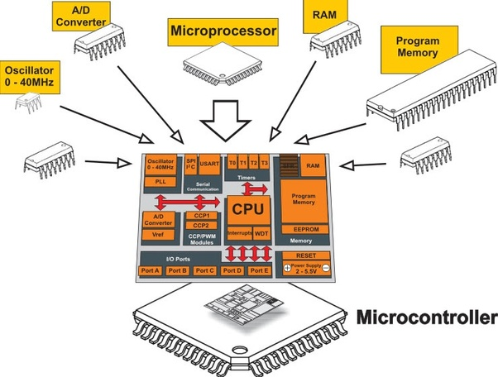
Microcontrollers
Memory
CPU
ROM RAM
I/O
Subsystems:
Timers, Counters, Analog
Interfaces, I/O interfaces
A single chip (SoC)

Slide 4
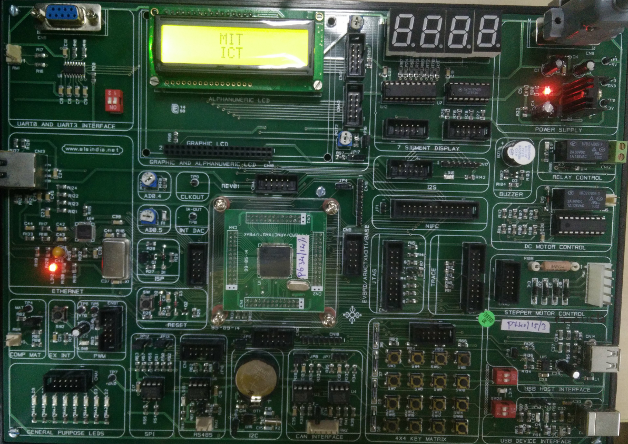
LPC 1768

Slide 5
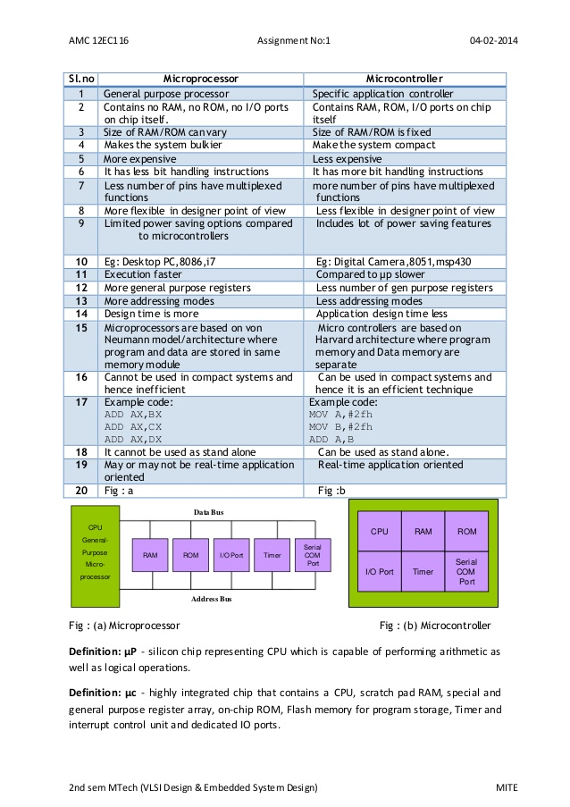
Microprocessor vs Microcontroller

Slide 6
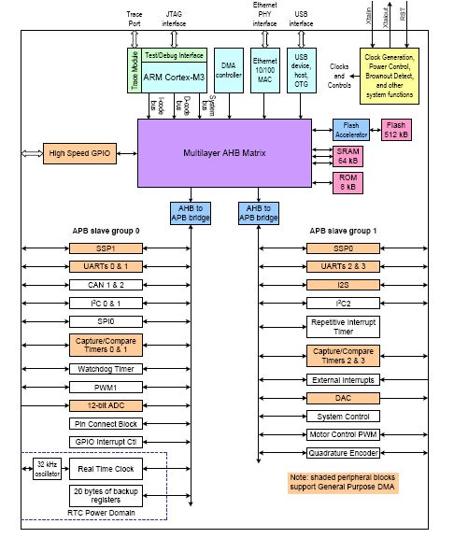
Microcontrollers

Slide 7
Embedded System
General Block Diagram
sensor
Microcontroller
(uC)
actuator
Sensor conditioning
Output interfaces
sensor
indicator
sensor

Slide 8



Embedded systems overview
Embedded computing systems
  Computing systems embedded within electronic devices
  Nearly any computing system other than a desktop computer
  Billions of units produced yearly, versus millions of desktop units
Lots more of these, though they cost a lot less each.

Slide 9
Some common characteristics of embedded systems
Single-functioned
  Executes a single program, repeatedly
Tightly-constrained
  Low cost, low power, small, fast, etc.
Reactive and real-time
  Continually reacts to changes in the system’s environment
  Must compute certain results in real-time without delay

Slide 10
An embedded system example -- a digital camera
Digital camera chip
CCD
A2D
CCD preprocessor
Pixel coprocessor
D2A
lens
JPEG codec
Microcontroller
Multiplier/Accum
DMA controller
Display ctrl
Memory controller
ISA bus interface
UART
LCD ctrl
Single-functioned -- always a digital camera
Tightly-constrained -- Low cost, low power, small, fast
Reactive and real-time -- only to a small extent

Slide 11
RISC vs CISC
RISC – Reduced Instruction Set Computer
CISC – Complex Instruction Set Computer
1. One of the major characteristics of RISC architecture is a large number of registers. All RISC architectures have at least 8 or 16 registers. Of these 16 registers, only a few are assigned to a dedicated function. One advantage of a large number of registers is that it avoids the need for a large stack to store parameters.
2. RISC processors have a fixed instruction size. In a CISC microprocessors such as the x86, instructions can be 1, 2, 3, or even 5 bytes. For example, look at the following instructions in the x86:

Slide 12
RISC vs CISC
3. RISC processors have a small instruction set. RISC processors have only basic instructions such as ADD, SUB, MUL, LOAD, STORE, AND, OR, EOR, CALL, JUMP, and so on.
The limited number of instructions is one of the criticisms leveled at the RISC processor because it makes the job of Assembly language programmers much more tedious and difficult compared to CISC Assembly language programming.
This is one reason that RISC is used more commonly in high-level language environments such as the C programming language rather than Assembly language environments.

Slide 13
RISC vs CISC
4. The most important characteristic of the RISC processor is that more than 99% of instructions are executed with only one clock cycle, in contrast to CISC instructions.
5. RISC processors have separate buses for data and code.

Slide 14
Microcontroller Architectures
Memory
Address Bus
0
Program + Data
CPU
Von Neumann
Architecture
Data Bus
2^{n}
Memory
Address Bus
0
Program
Fetch Bus
Harvard
Architecture
CPU
Address Bus
0
Data
Data Bus

Slide 15
RISC vs CISC
6. Because CISC has such a large number of instructions, each with so many different addressing modes, microinstructions (microcode) are used to implement them.
RISC instructions, however, due to the small set of instructions, are implemented using the hardwire method.
7. RISC uses load/ store architecture. In CISC microprocessors, data can be manipulated while it is still in memory.
8. Memory Mapped IO in RISC and IO mapped IO in CISC

Slide 16
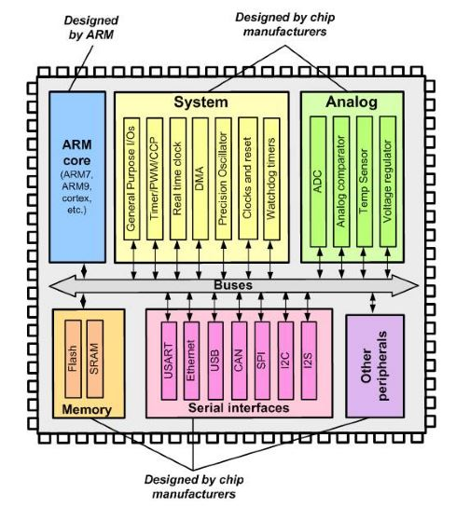
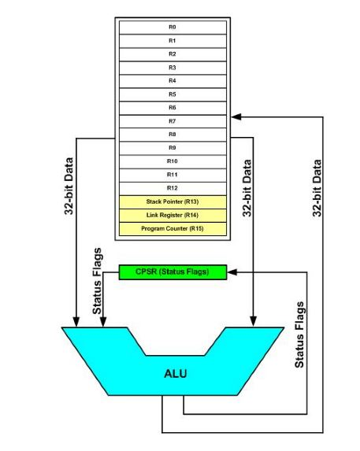
RISC vs CISC
N,Z,C,V flags
Bit No. 31, 30, 29. 28

Slide 17
Addressing Modes
The way in which an operand is specified in an instruction is called Addressing Mode
Register - MOV R0. R1
Immediate – MOV R0, #1
Register Indirect- LDR R0, [R1]
STR R0, [R1]
4. Indexed

Slide 18
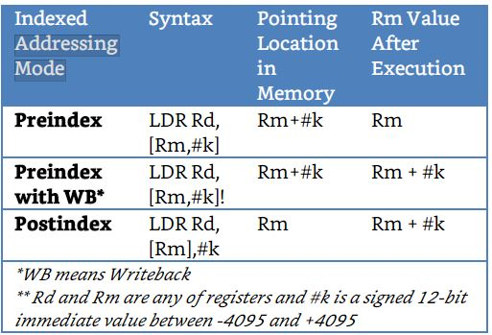
Addressing modes

Slide 19
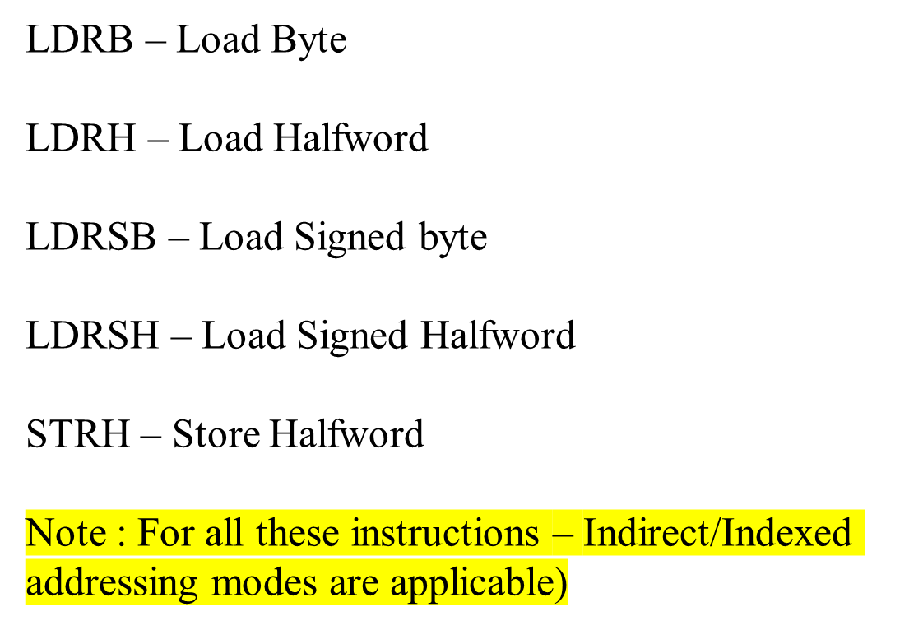
Load/Store Byte/Half Word

Slide 20
MOV instruction
MOV Rd, Rn
MOV Rd, #0x12
MOVW Rd, #0x1234 (Move Word)
MOVT Rd, #0x1234 (Move Top)
MVN Rd, Rn (Move Negative)
MVN Rd, #0x12
MSR Special_Function_Reg, Rn (Move SFR from Register)
MRS Rn, Special_Function_Reg (Move Register from SFR)

Slide 21
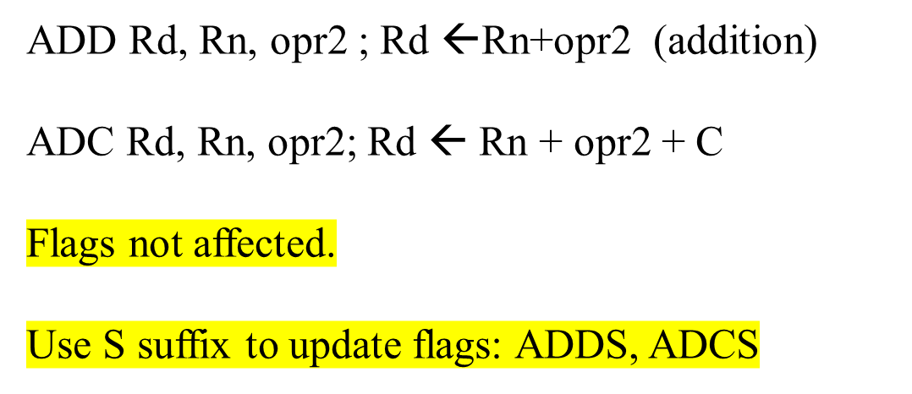
ADD instruction

Slide 22
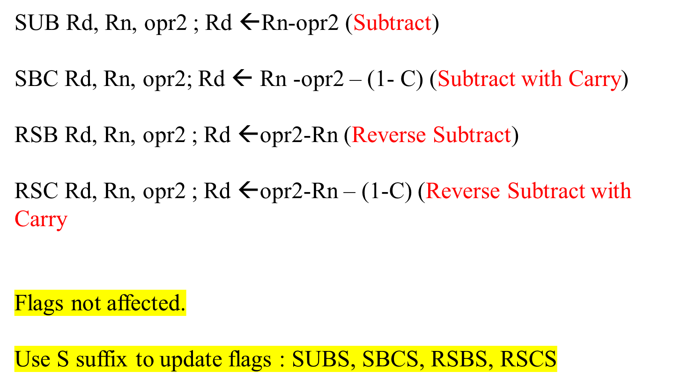
SUBTRACT

Slide 23
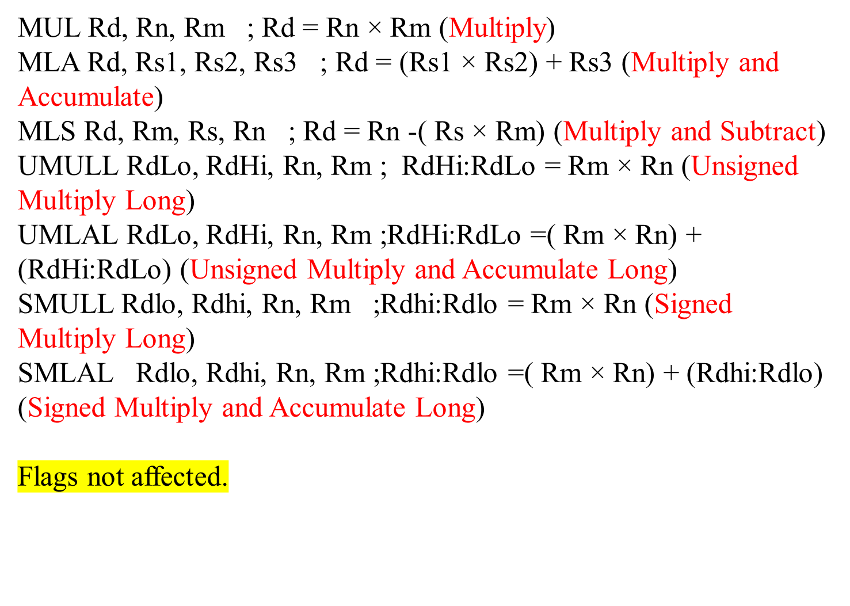
MULTIPLICATION

